Slide 1
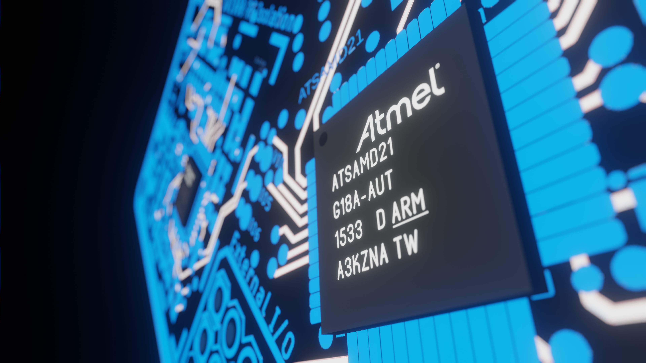
Atmel SAMD21
Main processor
48 MHz

Slide 2
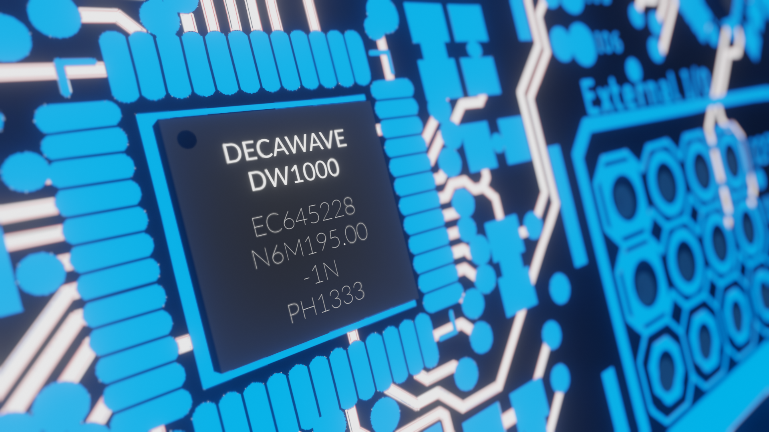
Decawave DW1000
ToF radio
3.5 – 6.5 GHz

Slide 3

Charging Circuitry
16 hour battery life

Slide 4

6 DoF IMU
Compass heading
Demonstrates telemetry capabilities

